Slide 1
CSE 331
Automata and computability
Lecture 10
Summer 2026

Slide 2
Today's learning goals Sipser Ch 1.2, 1.3
Convert between DFA to Regular expression

Slide 3
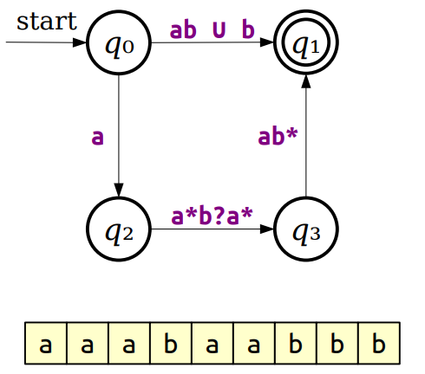
GNFA
GNFA: NFA with regular expressions on edges

Slide 4

Generalizing NFAs
Key Idea 1: Imagine that we can label transitions in an NFA with arbitrary regular expressions.
Key Idea 2: If we can convert an NFA into a generalized NFA that looks like this...
...then we can easily read off a regular expression for the original NFA.

Slide 5
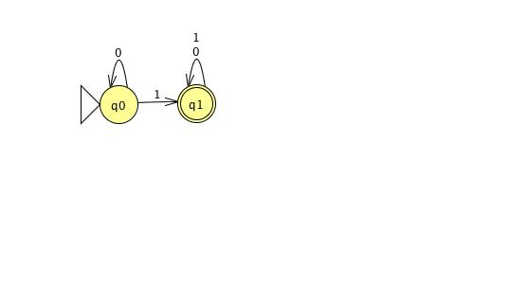
DFA to regexp Lemma 1.60, page 69
DFA
GNFA: start state →all, single accept, one arrow from all to all
GNFA with fewer states
2 state GNFA
Regular expression
Idea: use intermediate model GNFA whose labels are regular expressions
E.g.: build regular expression describing language recognized by

Slide 6
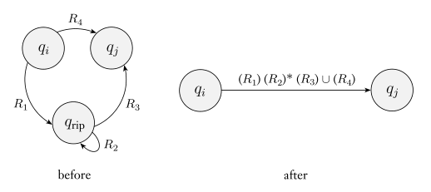
GNFA simplification
Simplify GNFA by removing one node at a time

Slide 7













GNFA simplification
$$qs$$
$$qs$$
$$qs$$
0
$$ε$$
$$0∪1$$
Remove q₀
$$0∪1$$
Remove q₁
$$0^{∗}1$$
$$q0$$
$$1$$
$$q1$$
$$q1$$
$$0^{∗}1{\left(0∪1\right)}^{∗}$$
$$ε$$
$$ε$$
$$qa$$
$$qa$$
$$qa$$

Slide 8
DFA to regexp exercise
Convert the following DFA to regular expression via GNFAs
1
0
0,1
0
1
A
B
C

Slide 9
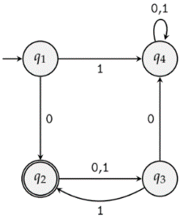
DFA to regexp exercise
Convert the following DFA into an equivalent regular expression using the state elimination method. First eliminate q₂, then q₃ and finally q₄. You must show work.

Slide 10
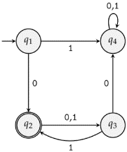

Slide 13
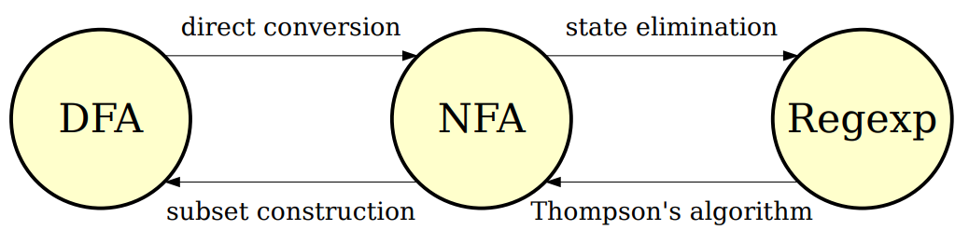
Our Transformations

Slide 14
The State-Elimination Algorithm
Start with an NFA N for the language L.
Add a new start state q_{s} (if there is an incoming transition to the original start state) and accept state q_{f} to the NFA.
Add an ε-transition from q_{s} to the old start state of N.
Add ε-transitions from each accepting state of N to q_{f} , then mark them as not accepting.
Repeatedly remove states other than q_{s} and q_{f} from the NFA by “shortcutting” them until only two states remain: q_{s} and q_{f} .
The transition from q_{s} to q_{f} is then a regular expression for the NFA.

Slide 15
The State-Elimination Algorithm
To eliminate a state q from the automaton, do the following for each pair of states q₀ and q₁, where there's a transition from q₀ into q and a transition from q into q₁:
  Let R_{in} be the regex on the transition from q₀ to q.
  Let R_{out} be the regex on the transition from q to q₁.
  If there is a regular expression R_{stay} on a transition from q to itself, add a new transition from q₀ to q₁ labeled ((R_{in})(R_{stay})*(R_{out})).
  If there isn't, add a new transition from q₀ to q₁ labeled ((R_{in})(R_{out}))
If a pair of states has multiple transitions between them labeled R₁, R₂, …, R_{k}, replace them with a single transition labeled R₁ ∪ R₂ ∪ … ∪ R_{k}.

Slide 16
All roads lead to … regular sets?
Are there any languages over {0,1} that are not regular?
Yes: a language that is recognized by an NFA but not any DFA.
Yes: there is some infinite language of strings over {0,1} that is not described by any regular expression.
No: all languages over {0,1} are regular because that's what it means to be a language.
No: for each set of strings over {0,1}, some DFA recognizes that set.
I don't know.

Slide 17
Bounds on DFA
in DFA, memory = states
Automata can only "remember"…
  …finitely far in the past
  …finitely much information
If a computation path visits the same state more than once, the machine can't tell the difference between the first time and future times it visited that state.

